Slide 1
Social Harms Reporting in ASPIRE Training Binder p.275

Slide 2
Social Harms
Social Harm - non-medical social consequence of study participation
Ex: stigma/discrimination from members of community or family, difficulties in personal relationships with partners, family, or friends
Ppts will be specifically asked about social harms every 3 months and at PUEV (via BA CRF), but can report (and site to document) a social harm at any time during the study
Care, counseling, follow-up provided per SSP guidance
Documented on Social Impact Log CRF at time of report
Notes:
Despite efforts to protect participant’s confidentiality and privacy, participants may experience social harms as a result of participating in ASPIRE. Social harms are defined as non-medical social consequences that are related to study participants and some examples include discrimination/stigma from community or family members or problems in personal relationships. Participants will be explicitly asked to report any social harms at each quarterly visit and at PUEV and should be encouraged to report social harms spontaneously at any study visit.
Strategies for preparing for and responding to social harms are detailed in the SSP.
For ASPIRE, we will capturing social harms that directly relate to study participation on a Social Impact Log CRF.
Next we will go through a couple scenarios when a social harm would be reported and how to document this incident.

Slide 3
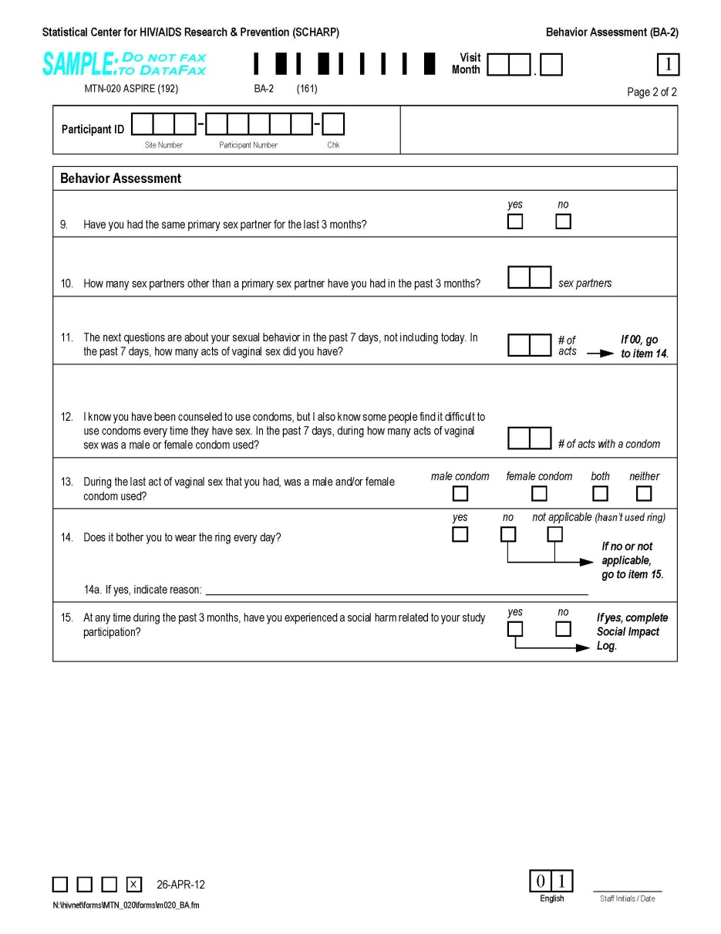
Social Harms – BA Trigger
Page 157
Item 15: Prompt for social harms quarterly and at PUEV (if not already reported)
If a social harm is reported in-between quarterly visits, still mark “yes” and make sure previously-completed SIL-1 is complete and no add’l follow-up is needed for the social harm

Slide 4
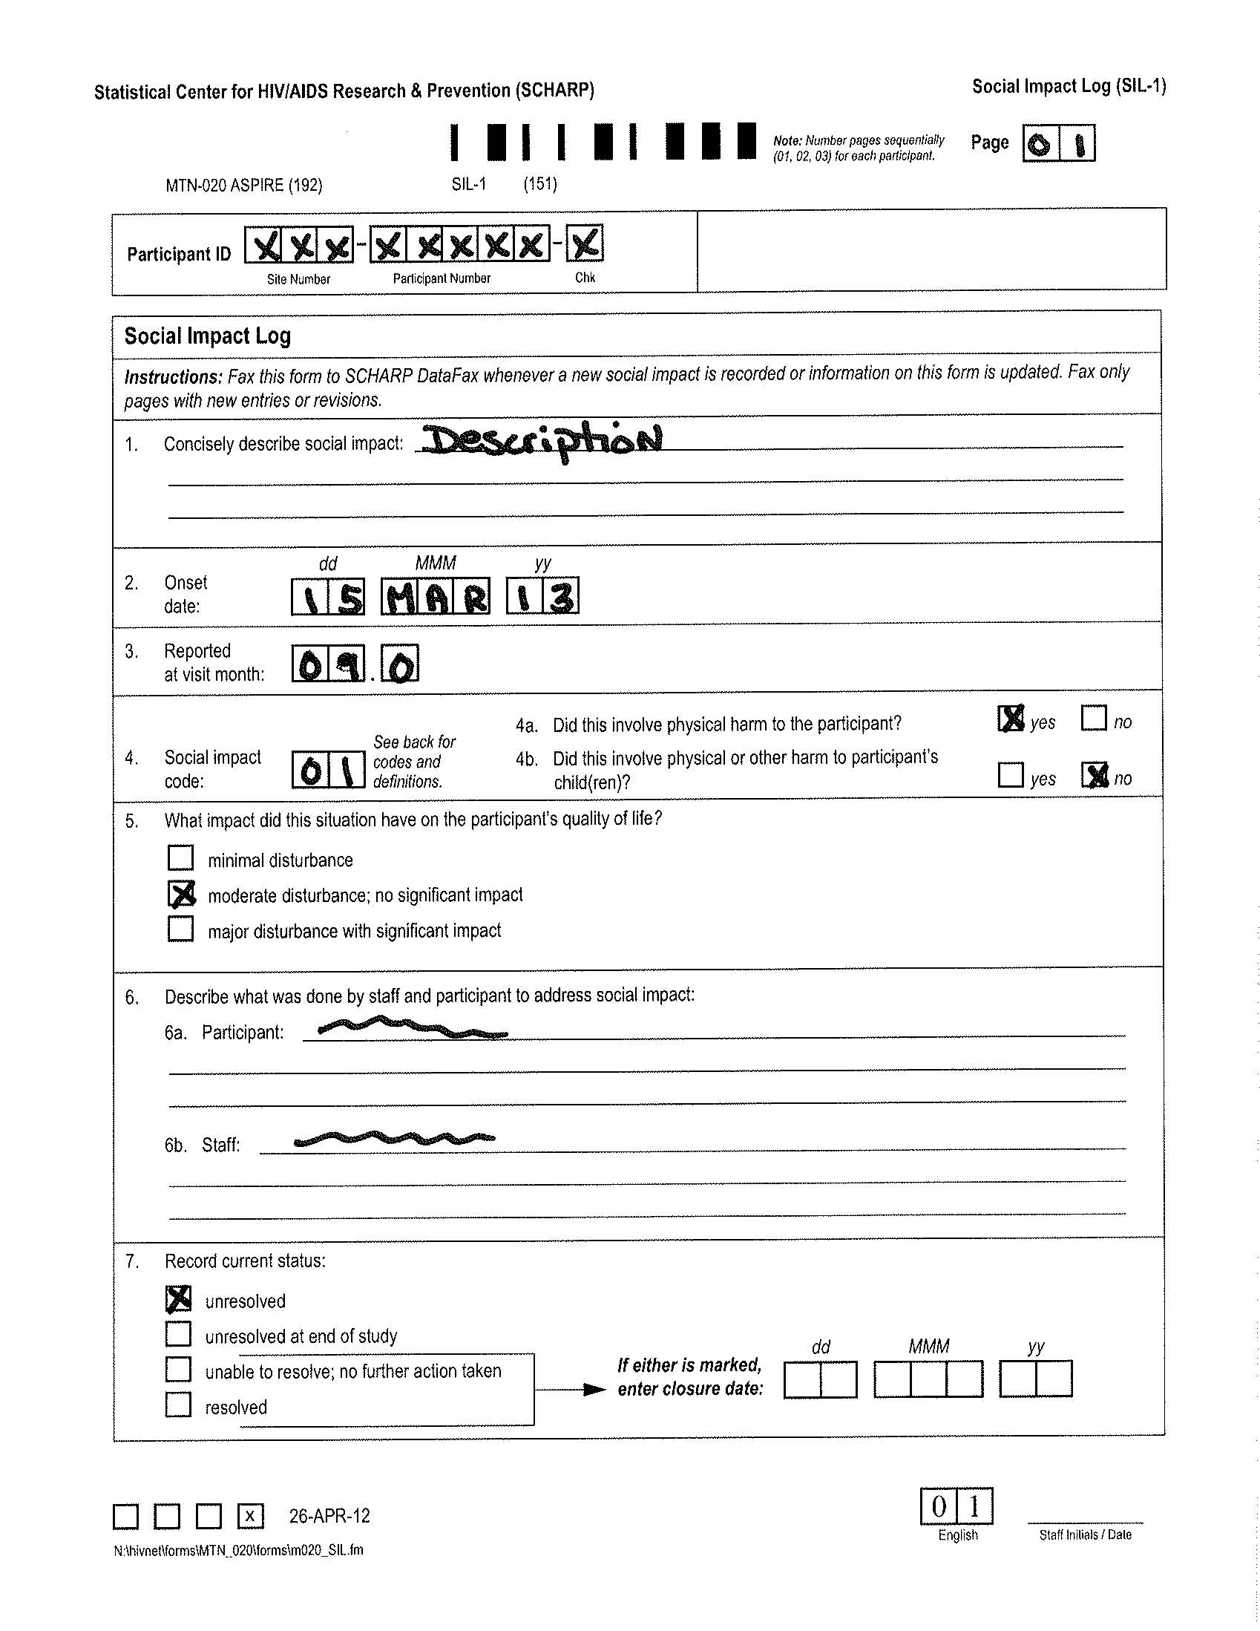
Social Impact Log CRF
Page 275
Social Impact Codes
Reporting of Physical Harm
Notes:
2 items to point out on the SIL form: Social impact codes for Item 4 and reporting of physical harm.
Item 7 can be updated at future visits once the social harm status changes.

Slide 5
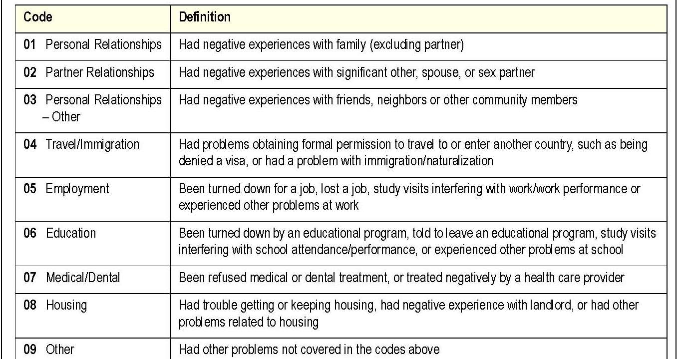
Social Impact Log CRF – item 4
If a social harm meets two or more codes, complete one SIL CRF for each code/each type of harm experienced
Social Impact Codes
Notes:
A list of social impact codes are included on the back instructions of the Social Impact Log CRF for your reference.

Slide 6
Social Impact Log CRF – con’t
Items 4a and 4b – mark if the social harm involved physical harm to the ppt or her children
Onset and resolution dates are per ppt report
Item 7 resolve date is when ppt felt the incident had resolved

Slide 7
Social Harms – Scenario #1
At Month 9 visit on March 23, 2013, participant reports that she had a physical fight with her sister on March 15 due to her sister’s disapproval with study participation.
How is this social harm documented?

Slide 8
Social Harms – Scenario #1
Item 4: Reporting of Physical Harm
0 1
If yes, report as an adverse experience.
Notes:
In this scenario, code ’01’, indicating that the participant had a negative experience with a family member, would be marked for the social impact code in Item 4. Item 4a would be marked ‘yes’ and 4b would be marked ‘no’. This physical harm would also be reported as an AE on the AE-1 log CRF.

Slide 9
Unresolved (Ongoing) Social Harms Report
SCHARP to provide a site specific monthly social harms report
Includes all ‘unresolved’ social harms that have been ongoing for more than 30 days
Can be used as a guide for resolving/follow-up on Social Harms
If social harm is continuing (per ppt), no action needed with regard to the CRF
If social harm has resolved, update SIL CRF item 7, initial, date and re-fax

Slide 10
What Are Your Questions?

